Slide 1
Drought: Wildfires and Food Shortages
Effects on the Poor www.newclimateguides.org
Marian Langhus, Ph.D.
Village of Gagetown, NB, Canada
Science Advisor
Notes:
Drought: Wildfires and Food Shortages
In preparing this talk, I was taken back when I realized how overwhelming the cost of climate change will be to the poor.
My husband and I have just started a new informational website entitled "NewClimateguides.org"
You can view this presentation and summaries of the impacts of climate change there.

Slide 2
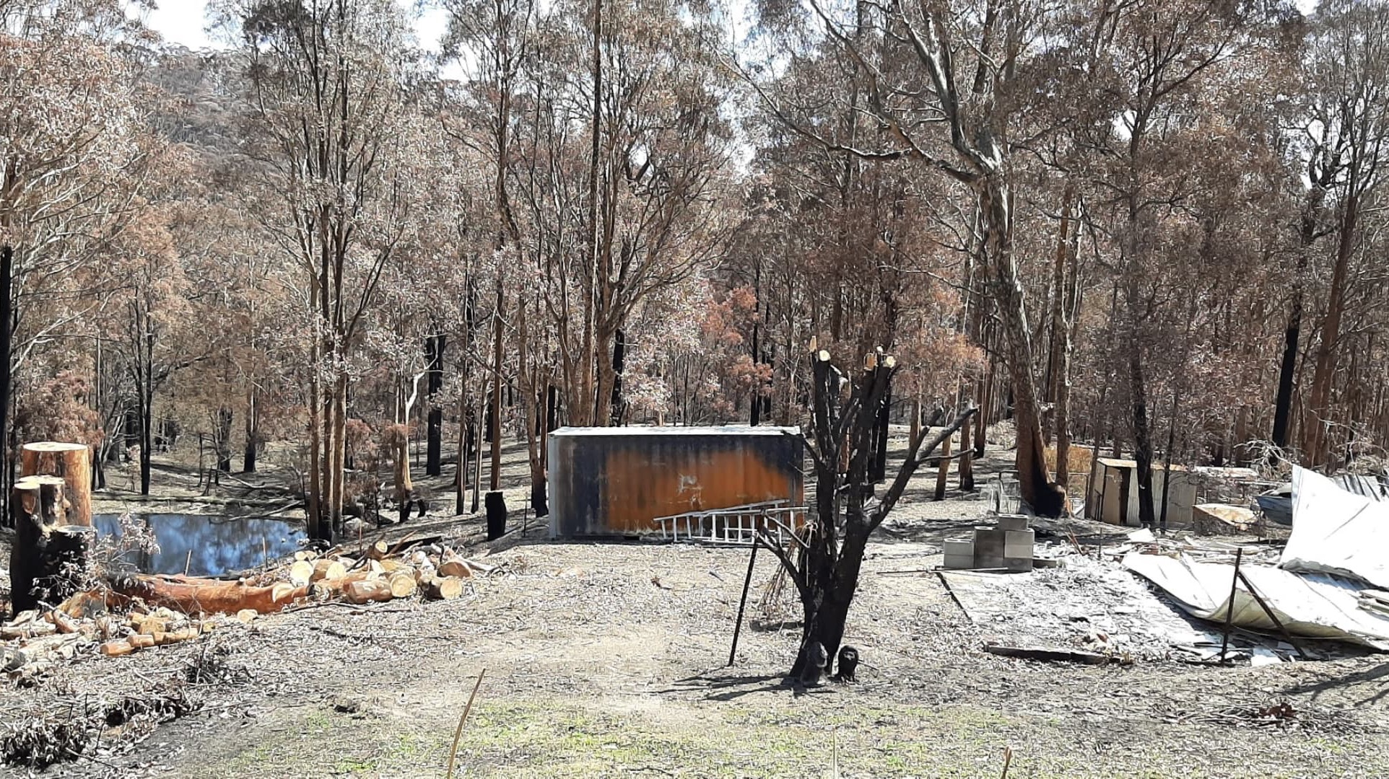
Effect of wildfire on the poor: loss of life, income, drinking water?
300,000
Deaths by wildfires per year
Notes:
Burn slides were sent to me by a filed coordinator for the Billy Graham Rapi Response Team during the fires in Australia in 2019.
The estimated deaths by wildfires are estimated at 300,000 per year. The effects on the poor are amplified in that not only their homes, but in many cases their livelihoods are lost. Reclaiming their land and groundwater may be out of reach.

Slide 3
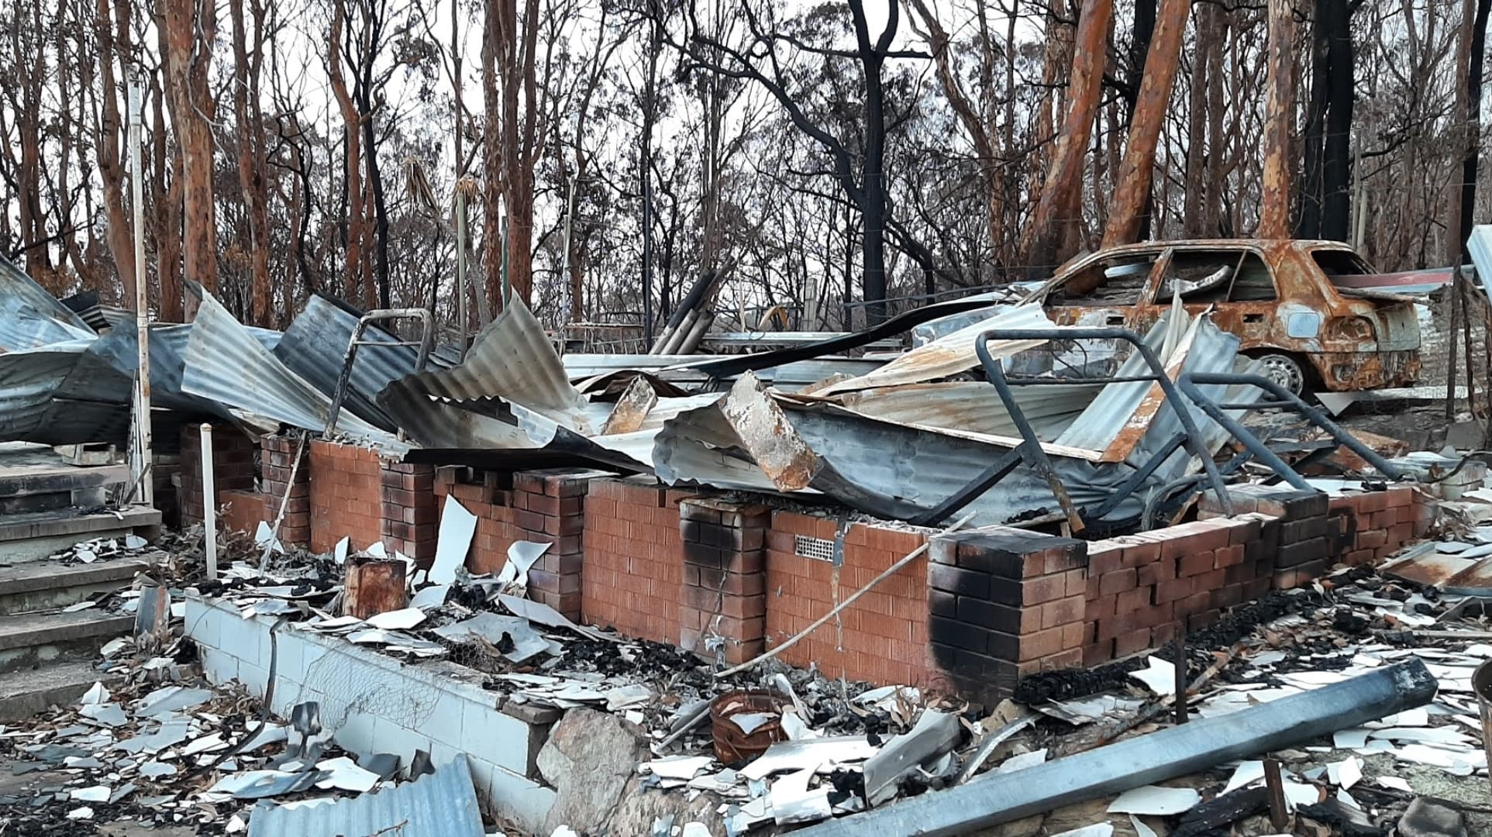
Will insurance pay? renew? Cost of prevention strategies $
Notes:
Will insurance companies:
Pay for a comparable rebuild?
Renew policies in a fire-prone area?
Homeowners may have to do costly mitigation efforts to make their lot insurable.

Slide 4
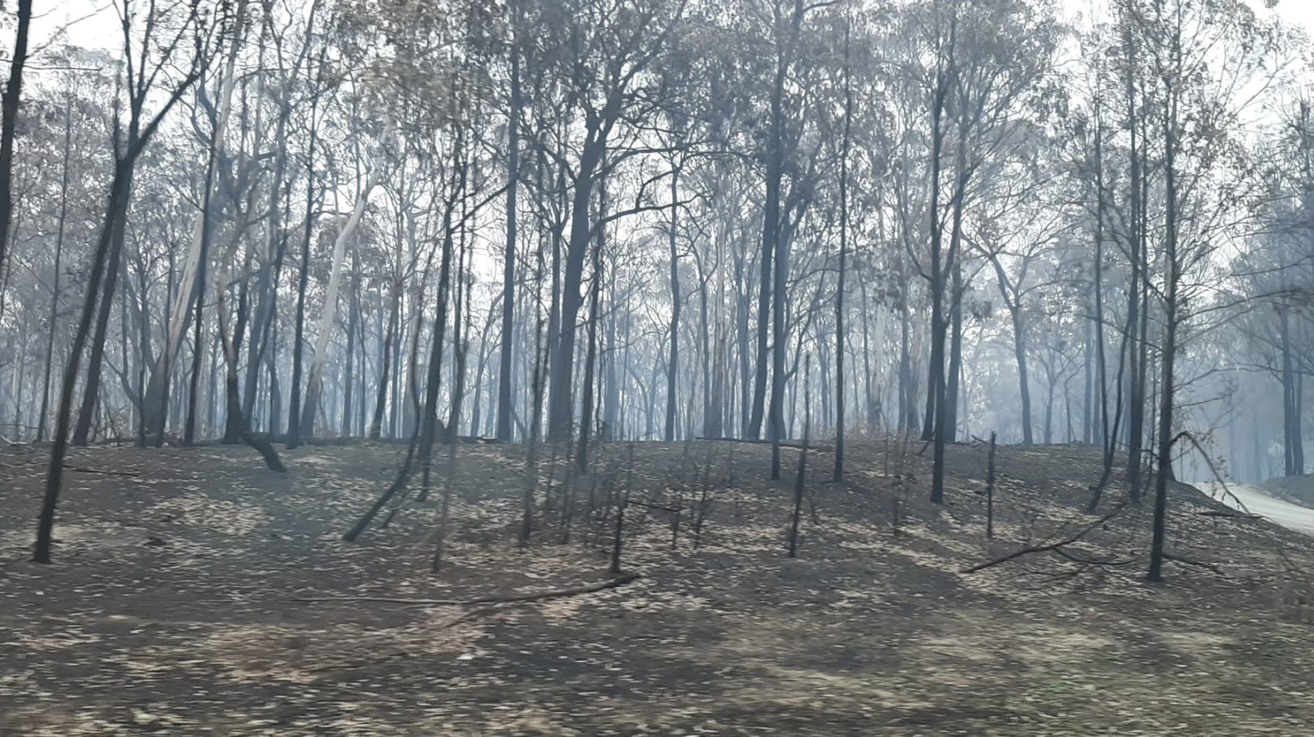
Health effects of wildfires-Aerosols (lungs, vascular, all organs)
Notes:
Last time I mentioned the effects of aerosols and heat to our bodies and that of our livestock. Once the fine particles enter the lungs, it travels through the blood stream and all organs.
Those exposed to the particulate matter are vulnerable to all kinds of physical agents, and in the deterioriztion to animal herds and wildlife.

Slide 5
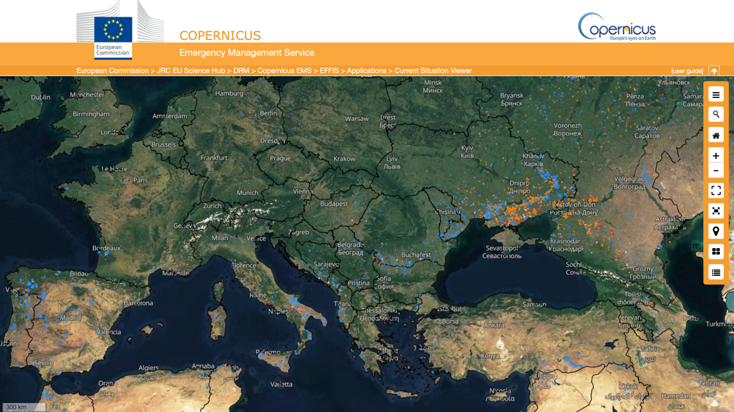
Europe’s total burn area in 2022 so far – 4x average 2006-21
Notes:
This summer's heat is global. Europe is suffering in both drought conditions and wildfires. So far this year, the area burned in Europe is 4x that of the average last 4 years.
This interactive site by the European commission shows orange dots for active burning and blue dots for recent, a week's burn. I read it as fires in Portugal are becoming less active but in Russia, north of the Black Sea, active fires are immense.

Slide 6
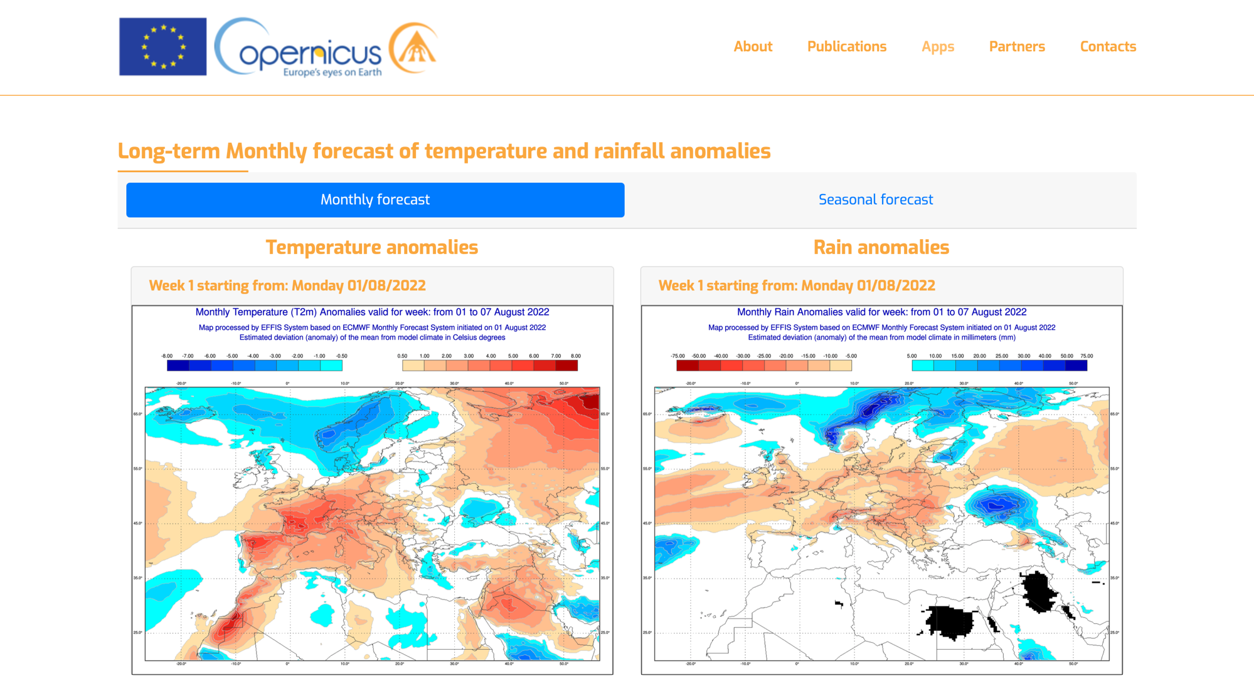
Notes:
Europe's forecast for this month shows most of it to have higher than normal temperatures and less than normal rainfall. The area that I mentioned north of the Black Sea appears to have rainfall above average. Spain and Portugal are more likely to be normal in rainfall. I will refer to this when I talk about agriculture.

Slide 7
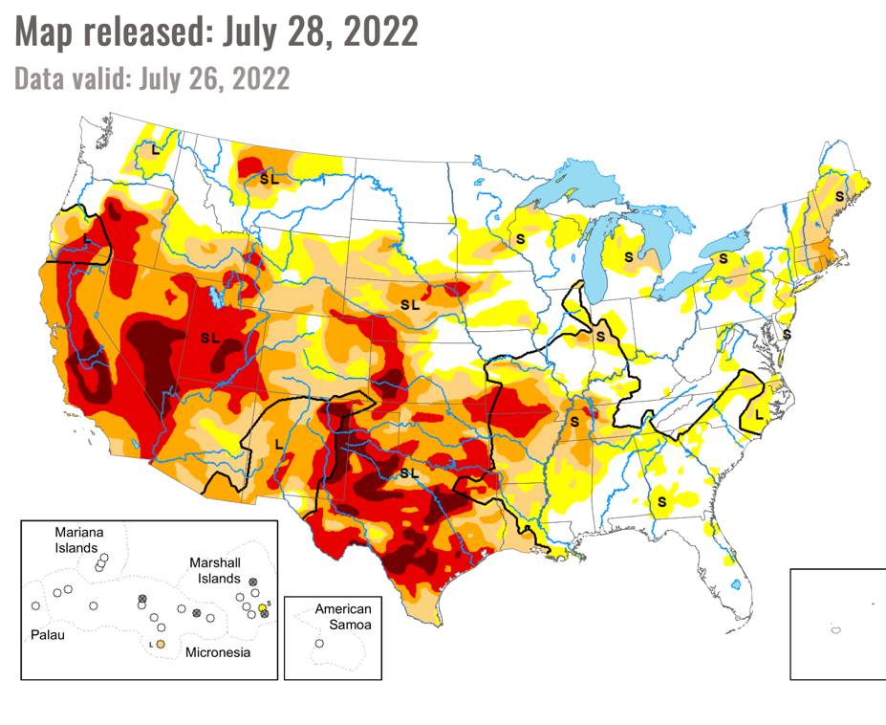
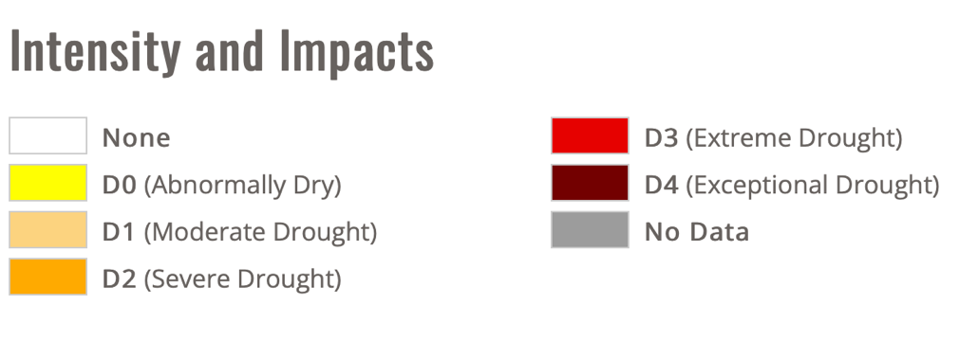
Notes:
By comparison in the US, Extreme and Exceptional Drought exists in many parts of CA, AZ, UT, KS, Tx, OK.
It is drier than usual in NJ and MA.

Slide 8
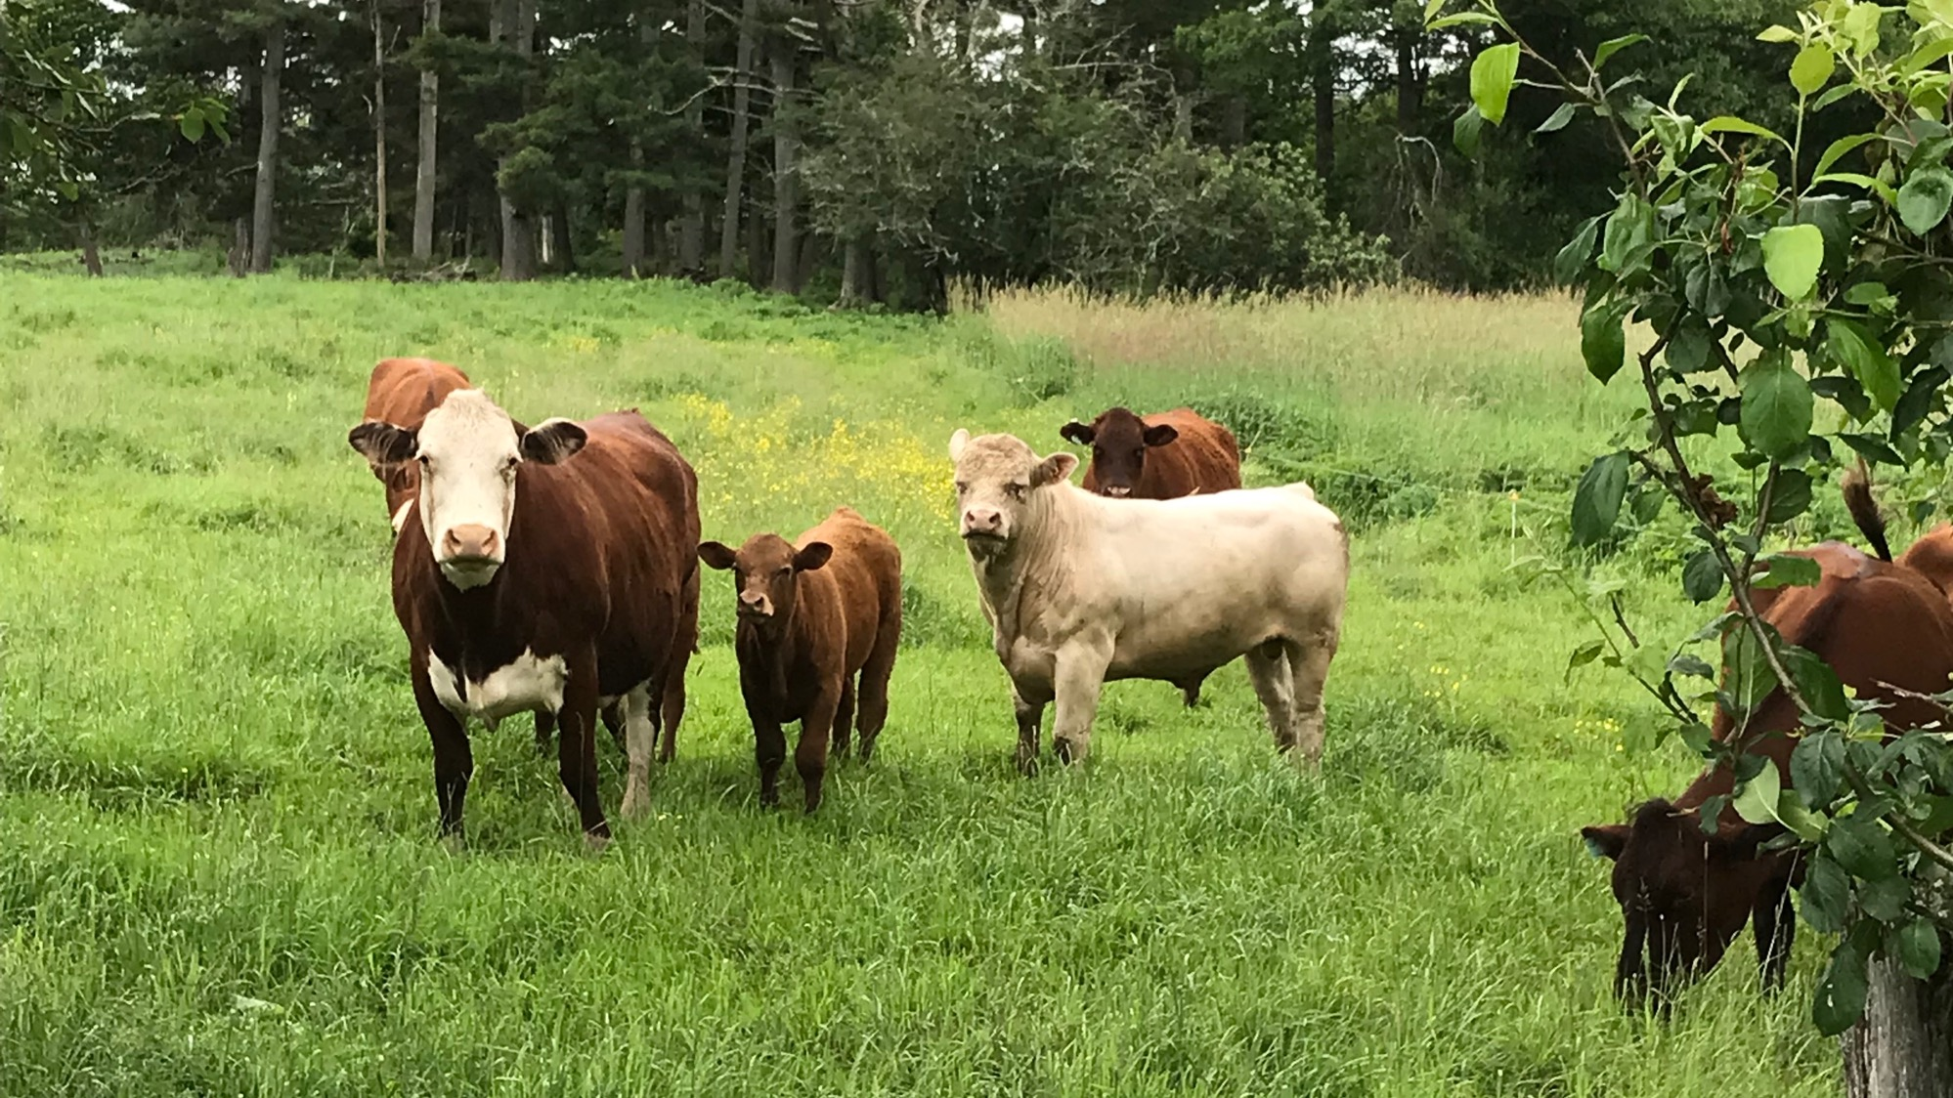
(2000-5000) Cattle loss due to heat. Workers endangered.
Feed lots not cooling down at night. Black cows affected the worst.
Notes:
Last time I talked about the dangers to cattle in the heat. Our neighbors are fine but out in KS, 2-5000 cattle died at feedlots. Black cows fared the worse.
Cattle cannot cool down enough at night. Workers risked their lives in caring for the cattle. The corpses overwhelmed landfills and exasperated their emergency plans for disposal.

Slide 9
New term: Climate forcing
Influence temperature, clouds, rainfall, air quality degradation
(300,000 deaths per year)
The formation of hurricanes in the Atlantic are being suppressed because of increased dry air coming off Africa.
"The average first Atlantic hurricane forms on August 11 and historically, 90% of major hurricanes form after August 20.”
Klotzbach Colorado State University.
Wildfires pollute the atmosphere
Notes:
You may be relieved that we have not had a start to the hurricane season this year.
It is a type of climate forcing.
Extra dry air coming off the African continent is suppressing the formation of hurricanes.
But next week this time, August 11, we may start to see the start of hurricane saeson.

Slide 10
New Term: Flash Droughts
Crop reduction (2020 - Canada)
  38% drop Wheat
  40% drop Canola
  More sudden than regular droughts
  When extreme heat and no precipitation combined
  Negative impact on agriculture and livestock
  Difficult to predict, can end quickly with rain
  Hard to assess; socioeconomic and hydrogeological.
This year so far: OK, KS, NJ
Notes:
A second new term is "flash droughts"
They are like flash floods in their suddenness and extreme impact.
Data out of Canada: 2020, wheat and canola production was reduced by 40%.
This year: OK, KS, and NJ (Christmas trees)
Extreme heat with no precipitation
Hard to predict and hard to assess.

Slide 11
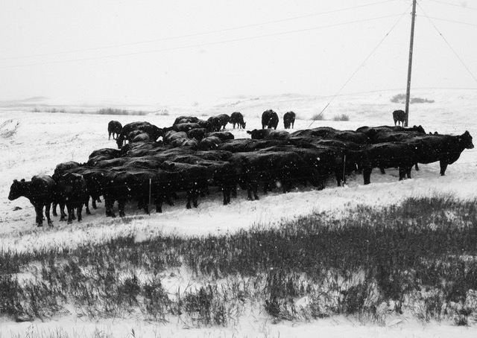
Affect of heat on agriculture
Damage or death to workers exposed to heat (food harvesting or feed lot or processing).
Heat stress and heat stroke; not being able to cool off at night.
Food scarcity (availability and cost):
Spain produces ½ the world’s supply of olive oil. This year’s harvest will be less than 20% of the last 5 years.
Rice growers in Europe facing no harvest and bankruptcy. Wheat, maize, oats are all affected.
Notes:
Nine years ago, in November, I took this picture of Black Angus cattle south of Watford City, ND, it is hard to believe that I would be using it to talk about the affect of heat on agriculture.
Hard to count but about 30 head here. Imagine thousands of corpses - dead from heat and being a worker dealing with this tragedy.
Food scarcity (if available - the costs?)
1/2 worlds olive oil comes from Spain.
This year's harvest will be less than 25% of the yearly average for the last 5 years.
Rice, wheat, maize, and oats are all affected by the drought this year. Entire villages with out an olive industry.

Slide 12

Coffee beans – Threatened by climate change
(too hot for plants, cannot move up more).
Fungus (coffee leaf rust)
120 million people work in the coffee business.
Notes:
Sad summary:
Threat to coffee (heat, fungus)
120 million rely on the industry.

